Slide 1
Computer Graphics
by
Dr. Metwally Rashad

Slide 2
Course work
Reading
- Reading from text book or give you book.
- There will be short in-class quizzes in most classes.
In-Class Exercises
- There will be graded in-class exercises that involve demonstrating a skill or
concept that has been taught.
Labs
- Projects.
1/23

Slide 3
Evaluation & Grading
Assessment Schedule: 3 assignments (due through the term)
  Assessment 1 Week 3
  Assessment 2 Week 5
  Assessment 3 Week 10
Grading:
  Mid Term Examination 15%
  Oral Examination 10%
  Practical Examination 10% + 5% (project)
  Final-term Examination 60%
2/23

Slide 4
Contents
Computer Graphics Hardware (Display and Input Devices)
Computer Graphics Software
Graphics Output Primitives
2D Geometric Transformations and 2D Viewing
3D Geometric Transformations and 3D Viewing
Computer Animation
3/23

Slide 5
What Is A Computer?
A computer is an electronic device, operating under the control of instructions (software) stored in its own memory unit, that can accept data (input), manipulate data (process), and produce information (output) from the processing. Generally, the term is used to describe a collection of devices that function together as a system.
What Do Computers Do?
Input
Process
Output
Store Data
4/23

Slide 6
How Does a Computer
Know what to do?
It must be given a detailed list of instructions, called a compute program or software, that tells it exactly what to do.
Before processing a specific job, the computer program corresponding to that job must be stored in memory.
Once the program is stored in memory the compute can start the operation by executing the program instructions one after the other.
5/23

Slide 7
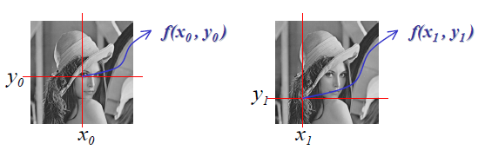
Image
- A 2D function and can be observed by human visual system.
- and are spatial (plane) coordinates.
- Amplitude of is called the intensity or gray level.
6/23

Slide 8
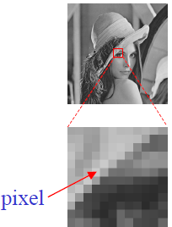
Digital Image
- , , are all finite and discrete quantities
- Composed of a finite number of elements
- These elements are referred to as
- picture elements
- image elements
- pixels - most widely used
- pixels are organized in an ordered rectangular array
- size of an image is determined by the dimensions of this pixel array
- pixel array is a matrix of M columns x N rows.
7/23

Slide 9
Definition of
Computer Graphics
Is the process of creation, storage and manipulation of models graphic images by means of a computer.
  Computer graphics started as a technique to enhance the display of information
  generated by a computer.
  This ability to interpret and represent numerical data in pictures has significantly
  increased the computer’s ability to present information to the user in a clear
  and understandable form.
  Large amount of data are converted into bar charts, pie charts, and graphs.
8/23

Slide 10
Definition of
Computer Graphics
Computer graphics deals with all aspects of creating images with a computer
  Hardware
  Software
  Applications
Computer graphics generates pictures with the aim of:
  to create realistic images
  to create images very close to “traditional” imaging methods
9/23

Slide 11
Computer Graphics fields
Computer Aided Manufacture (CAM)
Image Processing
Computer Vision
Computer Aided Design (CAD)
Visualization
10/23

Slide 12
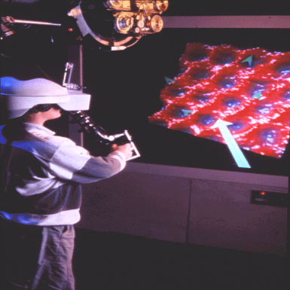
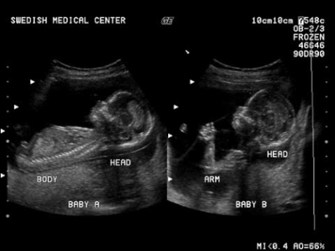
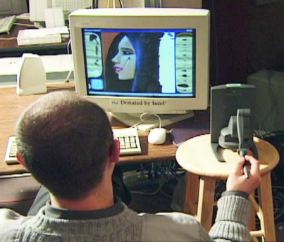
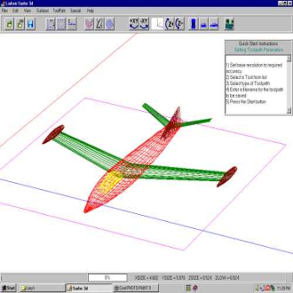
Computer Graphics
Applications
Virtual Reality
  VR: User interacts and views with a 3D world using “more natural” means
Data Visualization
  Scientific, Engineering, Medical data
  Visualizing millions to billions of data points
Education and Training
  Models of physical, financial, social systems
  Computer Aided Design (CAD)
11/23

Slide 13
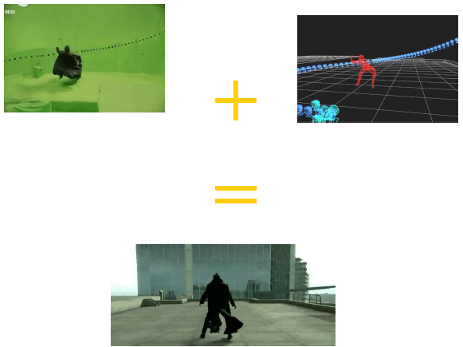
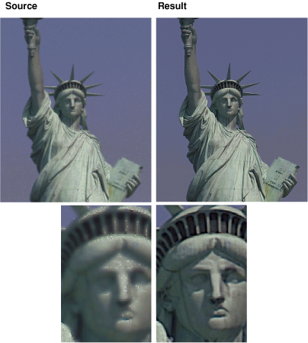
Computer Graphics
Applications
Computer Art and Design
  Fine and commercial art
  Performance Art
  Aesthetic Computing
Games/Movies
Image Processing
  ~Inverse of Graphics
  Start with a picture
  Process picture information
Graphical User Interfaces (GUIs)
  WIMP interface
  HCI
12/23

Slide 14
Graphics Systems
Images
Hardware
  Input Systems
  Output Systems
Software
  OpenGL
13/23

Slide 15
Graphics Definitions
Point
- a location in space, 2D or 3D
- sometimes denotes one pixel
Line
- straight path connecting two points
- infinitesimal width, consistent density
- beginning and end on points
Vertex
- point in 3D
14/23

Slide 16
Graphics Definitions
Edge
- line in 3D connecting two vertices
Polygon
- arbitrary shape formed by connected vertices
- fundamental unit of 3D computer graphics
Mesh
- set of connected polygons forming a surface (or object)
15/23

Slide 17
Graphics Definitions
Models
- 3D representation of something is called model
Rendering (image synthesis)
- Process of generating an 2D image from 3D models by means of
computer programs. Also the results of displaying such a model can
be called a render
- One of the major sub-topics of 3D computer graphics
Animation
- Techniques of creating illusive movements using successive images is
called animation
16/23

Slide 18
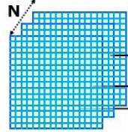
Graphics Definitions
Frame buffer
Frame buffer - A block of memory, dedicated to
graphics output, that holds the contents of what will
be displayed.
Pixel - one element of the frame buffer
17/23

Slide 19
Graphics Definitions
Frame buffer
- Each screen pixel corresponds to a particular entry in a 2D array
residing in memory. This memory is called a frame buffer or a bitmap.
- Number of rows in the frame buffer equals to the number of raster lines on the screen.
- The number of columns in this array equals to the number of pixels on each raster line.
18/23

Slide 20
Graphics Definitions
Frame buffer
- The term pixel is also used to describe the row and the column
location in the frame buffer array that corresponds to the screen
location.
- Whenever we wish to display a pixel on the screen, a specific value is
placed into the corresponding memory location in the frame buffer
array.
19/23

Slide 21
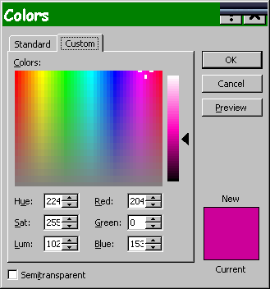
Graphics Definitions
Frame buffer
bit depth - number of bits allocated per pixel in a buffer
We are asking how much memory
do we allocate to store the color
at each pixel?
- Common answers:
  16 and 32 bits
20/23

Slide 22
Graphics Definitions
Frame buffer
16 bits per pixel (high color)
- 5 bits for red, 5/6 bits for green, 5 bits for blue
- 32 bits per pixel (true color)
  8 bits for red, green, blue, and alpha
- If we want a frame buffer of 640 pixels by 480 pixels, we should allocate:
1. Frame buffer = 640*480 *16 bits
  2. Frame buffer = 640*480 *32 bits
21/23

Slide 23
Computer Graphics
Operations
Modeling
- Coordinates of the ‘corners’ of objects
- Primitives (2D & 3D geometric objects)
- Equations that define the 2D & 3D shape of objects
- Attributes (color, surface texture, etc.)
Storing
- (first in memory), then on disk
22/23

Slide 24
Computer Graphics
Operations
Manipulating
- Change shape
- Change position
- Change characteristics
Rendering
- Create a picture by applying an algorithmic version of the physics of
the real world to create the artificial image.
Viewing
- Display scene from various viewpoints
23/23

